Slide 1
Multi-Modal Classifiers For Open-Vocabulary Object Detection

Slide 2
Abstract
Open-Vocabulary Object Detection
building a model that can detect objects beyond the set of categories seen at training, thus enabling the user to specify categories of interest at inference without the need for model retraining.

Slide 3
Standard Two Stage Object Detector Architecture
Prompt an LLM to generate informative language descriptions for object classes and construct text based classifiers .
Use a visual aggregator on image exemplars, forming vision-based classifiers
Figure out a simple method to fuse information.
Use the fused / multi-modal classifier for object detection

Slide 4
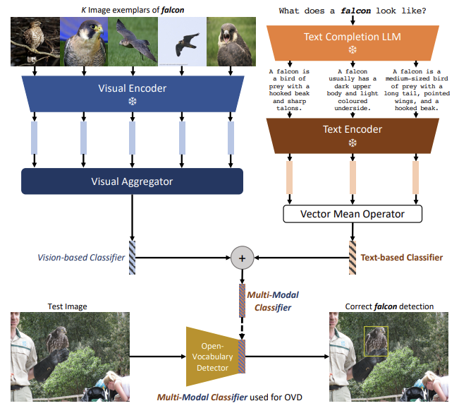
Overview of the architecture of generating text-based, vision-based, or multi- odal classifiers for OVOD

Slide 5
Why not use the text embeddings and why even go multi-modal ?
Using text can potential lead to lexical ambiguities. Example: “nail” can be either referred to “the hard surface on the tips of the finger” or “a small metal spike with a flat tip hammered into wood to form a joint”.
the class name of interest may be unknown. example: assume the vocabulary you use doesn’t contain the word “dugong”, refers to a herbivorous marine mammal with an adorable, plump appearance, a dolphin tail, round head and downward snout.

Slide 6
Why not use the text embeddings and why even go multi-modal ?
In cases where multi-modal in preferable to specify the category of interest. example: suppose you are a bug collector, and you want to identify a species of butterfly with a distinctive wing pattern, in this case give a text description may not be enough.
Some more examples:
a. “What does a dalmatian look like?”, using an LLM yields “A dalmatian is typically a large dog with a short coat of black spots on a white background”.
b. the dog breeds “pug” and “bulldog” have similar descriptions, we can generate classifiers from image exemplars

Slide 7
Related Work
Closed-Vocabulary Object Detection : This is one of the classical computer vision problems. which is finding the class and the bounding box. in CVOD, only objects seen at training time can be detected during inference time, thus termed closed vocabulary
Open-Vocabulary Object Detection: detect objects beyond the set of categories seen at training, thus enabling the user to specify categories of interest at inference without the need for model retraining.
the paper mentions, OVOD has seen increased attention and progress primarily driven by the emergence of large-scale vision-language models (VLMs). so what is VLM?

Slide 8
VLM
VLMs or Visual-Language Models can understand and generate both visual and linguistic information. They are trained on large datasets of image-text pairs, and can be used for a variety of tasks, such as:
image captioning: generating a natural language description of an image
visual question answering: answering questions about an image using natural language
text based image retrieval: finding images that match a given text query
visual dialog: carrying on a conversation about an image
Some examples are CLIP, VisualBERT, ViLBERT, LaMDA, Gopher
Coming back to OVOD, The paper mentions about other works for OVOD such as: ViLD (Gu et al., 2022), RegionCLIP (Zhong et al, 2022), GLIP and MDETR (Li et al, 2022; Kamath 35 al., 2021), OVR-CNN(Zareian et al., 2021), OWL-ViT (Minderer et al., 2022), OV-DETR (Zang et al., 2022)

Slide 9
Few Shot Learning v/s Our Approach
The approach mentioned in the paper is different from few shot learning as follows, in Few Shot Learning we have a few annotated examples to learn from, here we don’t have any annotated examples to learn from instead we try to learn the classifiers.

Slide 10
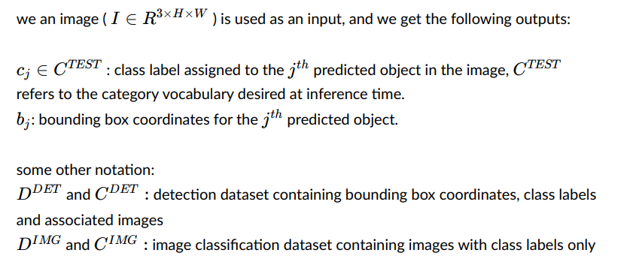
Preliminaries

Slide 11
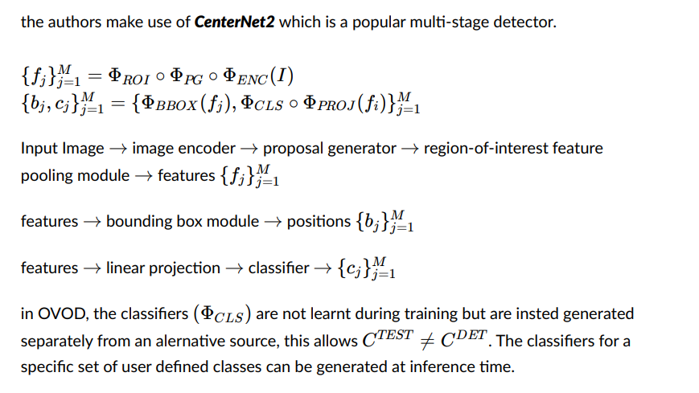
Architecture Overview
Note:
CenterNet2 was introduced in the paper “Probabilistic Two-Stage Detection”

Slide 12
Text-Based Classifiers from Language Descriptions
We use natural language descriptions of categories sourced from a large language model (LLM). Such a design choice gives additional details like visual attributes, leading to increased discriminative information in classifiers. this eliminates lexical confusion {remember the old example “nail”}.
All this becomes clear in the next slide

Slide 13
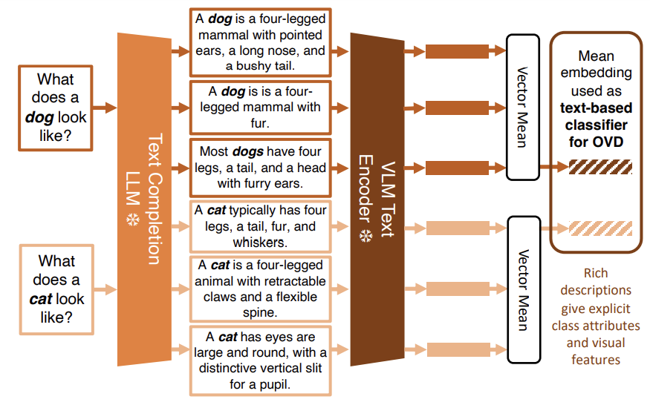

Slide 14
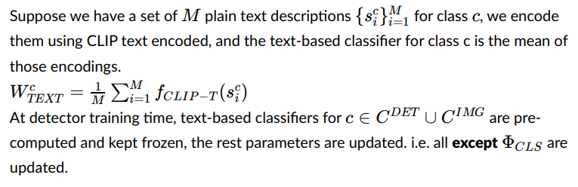
The Mathematical Representation
Note: The authors also tried to use the transformer architecture to aggregate the text embedding from natural language descriptions, but they found that it was not beneficial to OVOD performance over simply using the mean vector.

Slide 15
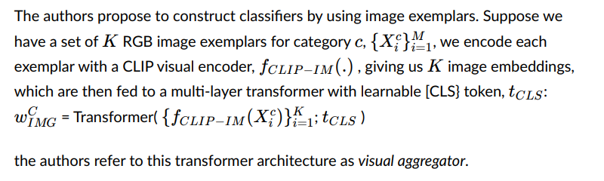
Vision-Based Classifiers from Image Exemplars

Slide 16
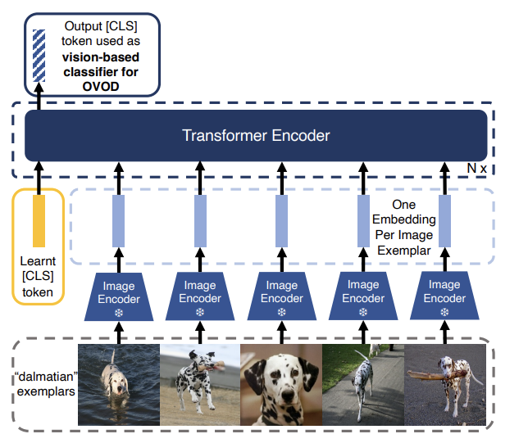
Generating an OVOD vision-based classifier from a set of image exemplars

Slide 17
Training Process
The CLIP image encoder is frozen during training to improve training efficiency and prevent forgetting of the CLIP representation
To provide discriminative vision-based classifiers, contrastive learning is utilised. For a given class, the output embedding from the visual aggregator is trained to minimise similarity with the output embedding from other classes and maximise the similarity with an output embedding from same class. To do this contrastive InfoNCE loss is used.
The visual aggregator is trained offline i.e. it is not updated during detector training
The visual aggregator was trained on ImageNet-21k-P dataset which contains about 11M images across about 11K classes.

Slide 18
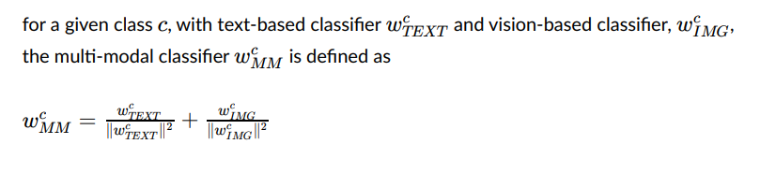
Constructing Classifiers via Multi-Modal Fusion

Slide 19
Results
The authors compared their work with the previous work. Using the LVIS Open Vocabulary Benchmark and the results are on the next slide
For more details about the architecture one can checkout the paper. which data, batchsize, how many transformer encoders, which LLM?..
For the paper click here

Slide 20
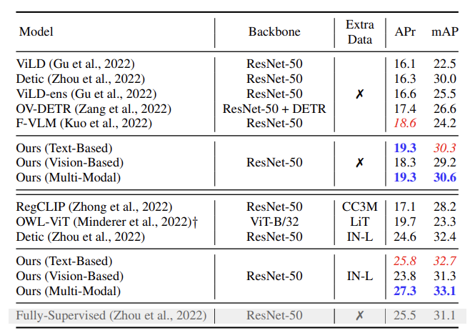
APr - Average Precision Rate
mAP - Mean Average Precision
Basically, higher the value better the performance.

Slide 21



